Slide 1
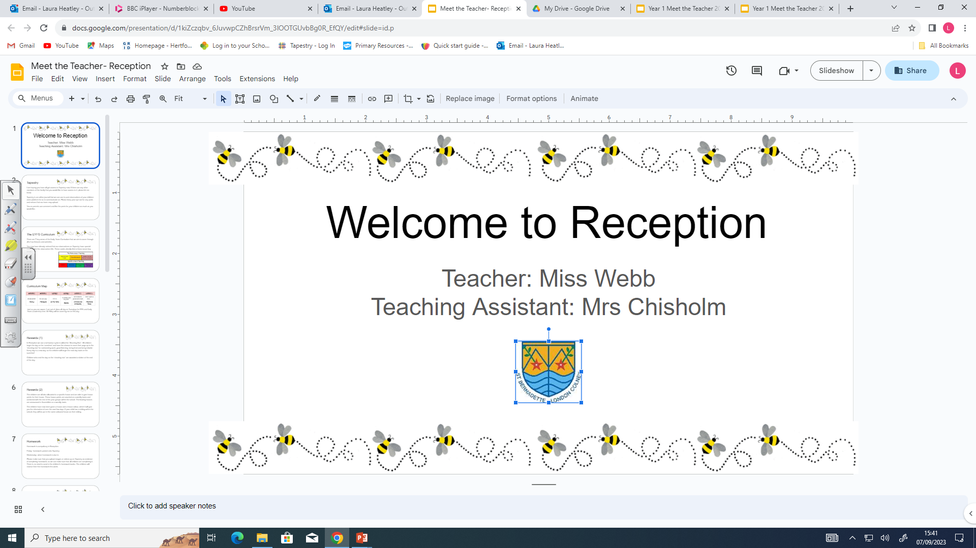

Teacher: Mrs Heatley
Part time teaching assistants:
Mrs Campanella, Mr Riley and Miss Rickard.

Slide 2


This is my 4rd year St Bernadette, but I have been teaching
for 28 years!
I have worked in 2 other Catholic primary schools in the
London Borough of Haringey and was in my last school for 19
years! My daughters attended the school too.
I have worked in various year groups, from Reception to Year 3.
But the majority of my career has been in Early Years.

Slide 3

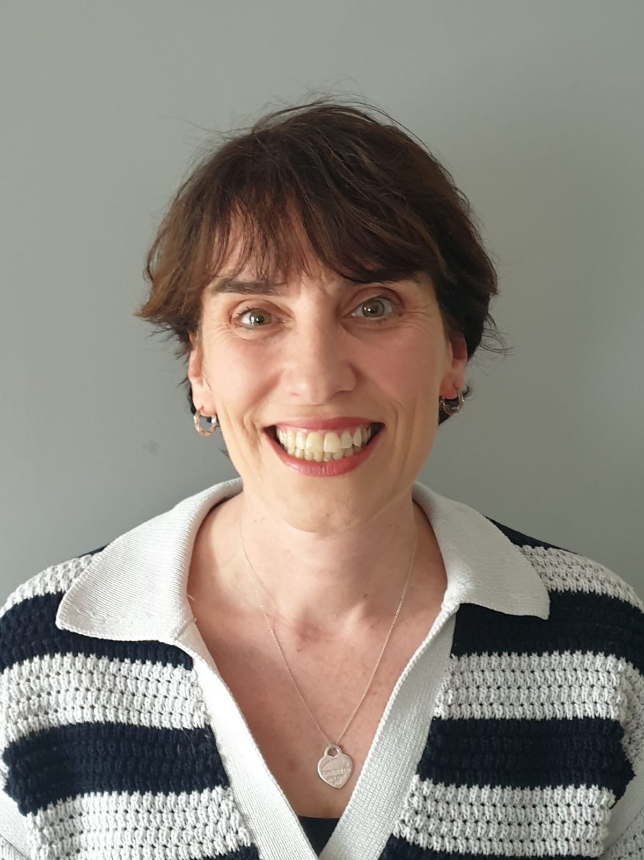
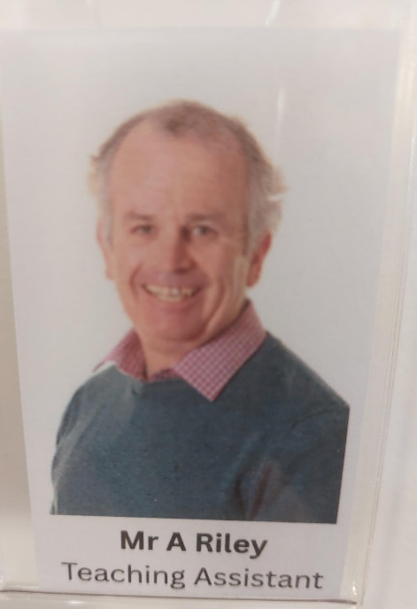
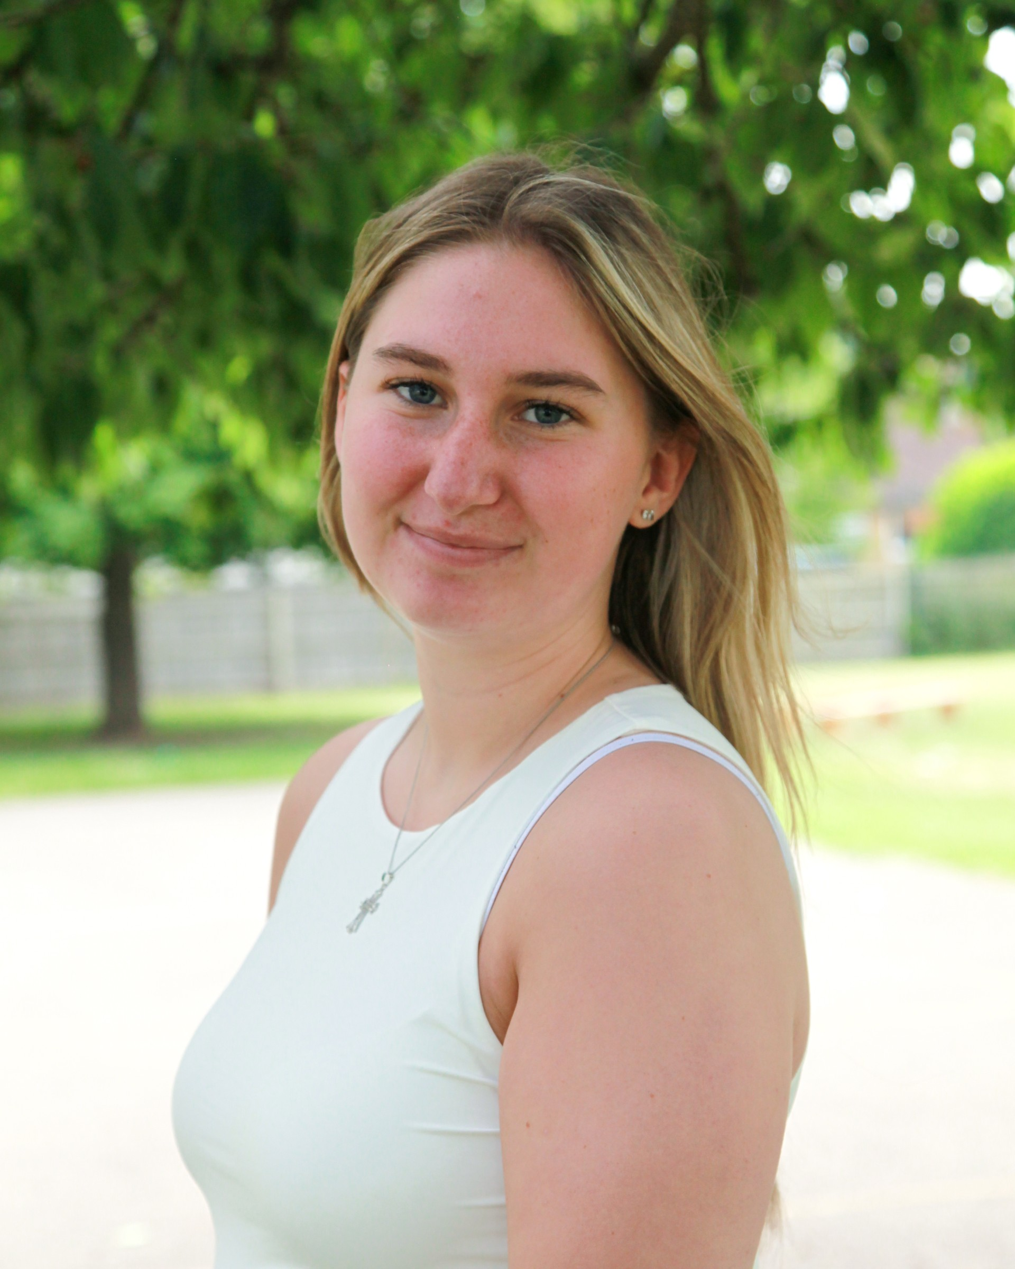
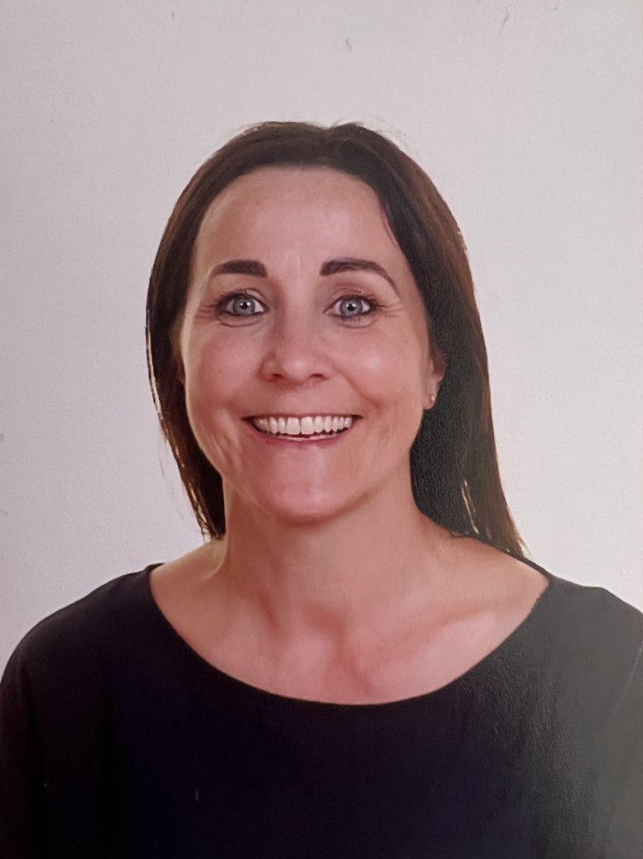
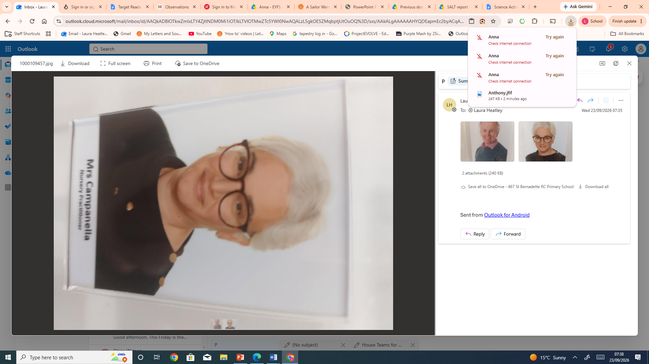
St Bernadette Catholic Primary School
“Learning to grow in knowledge, faith and love through friendship with Jesus and Mary.”
Meet the Reception Team
Mrs Heatley
(Class Teacher & Early Years Leader)
Mrs Campanella
(SEN Support )
Miss Rickard
(SEN support )
Mrs Chisholm
(Teaching Assistant
Full time )
Mr Riley
(SEN support)
Notes:
Meet the Team!
You will be able to meet all these staff members later on this afternoon.
Mrs Chisholm has worked in this school for a number of years. I have been lucky enough to have had Mrs C as my TA for ⅗ years
Miss Guan has been working as an additional member of staff in our Nursery this year, so will join the children as they move into Reception
Mrs Ruata is a new member of staff who will be officially joining us in September. She is very passionate about supporting children with learning barriers
Mrs Heatley is a new member of staff. She has a lot of experience in Early Years and is really keen and excited about joining our school!
I am going to pass you over to Mrs Heatley now, who will explain a few things about what to expect in September during those first few weeks in school

Slide 4
Staff working in Reception
PPA Cover – Miss Weston (Monday and Wednesday afternoon)
Every teacher is given PPA time each week (Planning, Preparation and Assessment time)

Slide 5
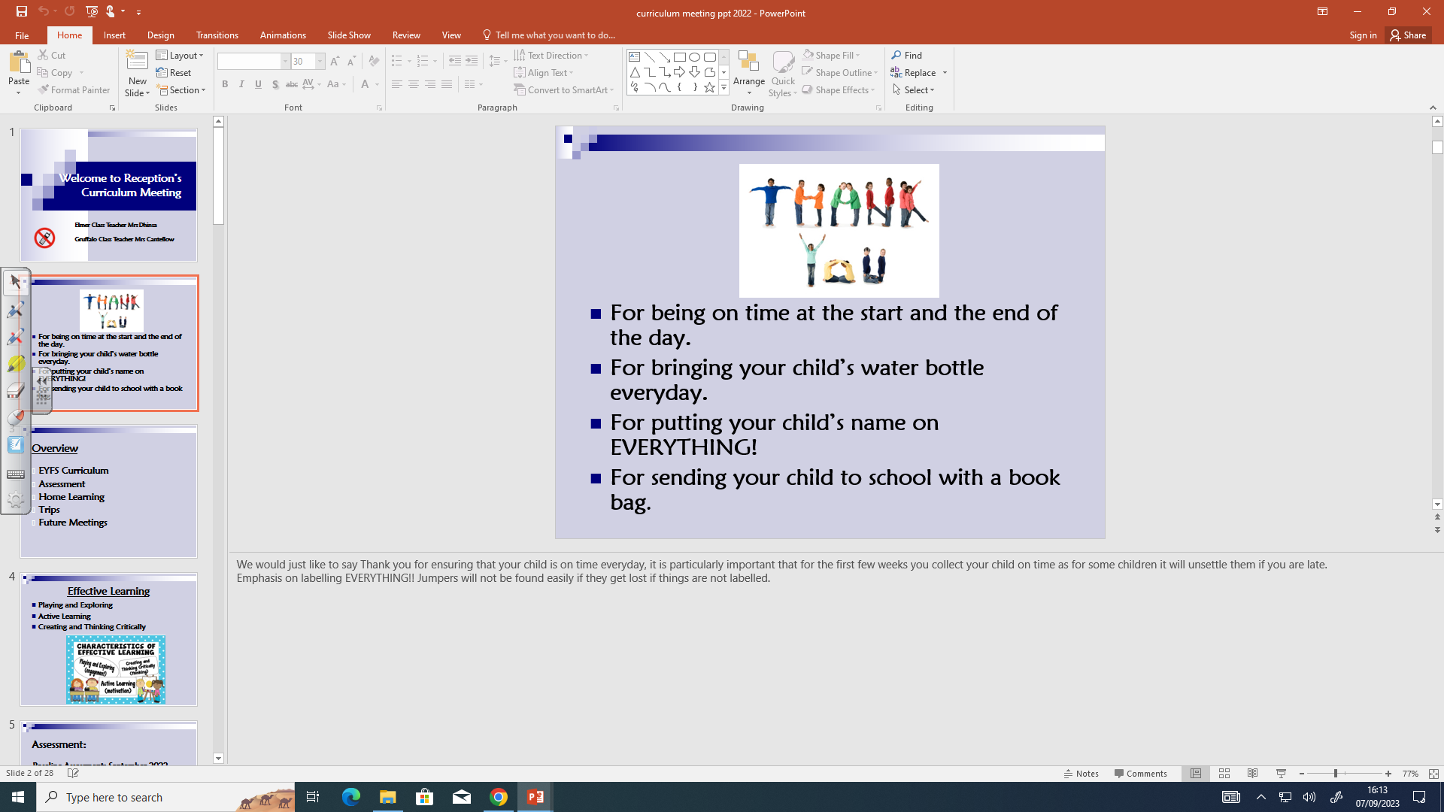

Slide 6
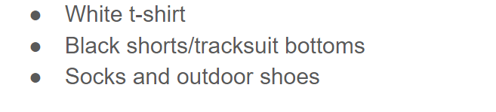
Routines:
P.E lessons are on Tuesday mornings. The children can come to school on a Tuesday in their P.E kit.
Later on in the year we will ask for their P.E kits to be brought into school but for the beginning
of the year the children come to school ready for P.E.
The P.E kit consists of:

Slide 7
Book changing will be on Tuesday.
Your child will receive one book from our reading scheme. We will also go to the school library on a Friday where your child can chose a book for you to share with them.
The books we send home first have no words in them, please do not worry! Encourage your child to tell you the story using the pictures. Talk about what will happen next, what the characters are doing, where is the story set etc.
Please ensure your child has their reading diary, scheme book and library book in their book bag on Tuesday. Also ensure you have initialled the reading diary so that we can change your child’s book. If it is not initialled or a comment written we will not change it.

Slide 8
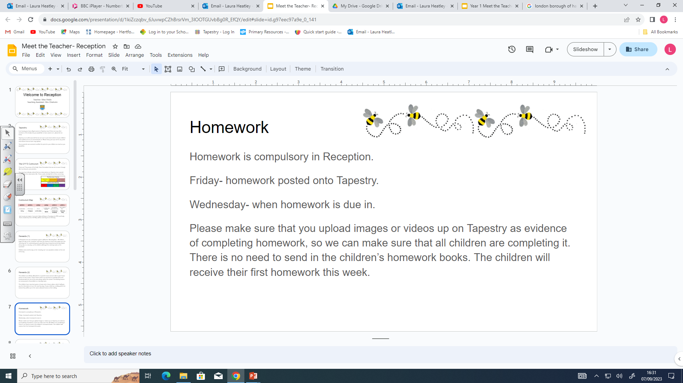
We have also given you green books to practice letter formation in and then later
on it will be writing words and then sentences.
Pencil grip and correct letter formation is really important and we will do
lots of work around this in Reception so if you could support at home that would be great!

Slide 9
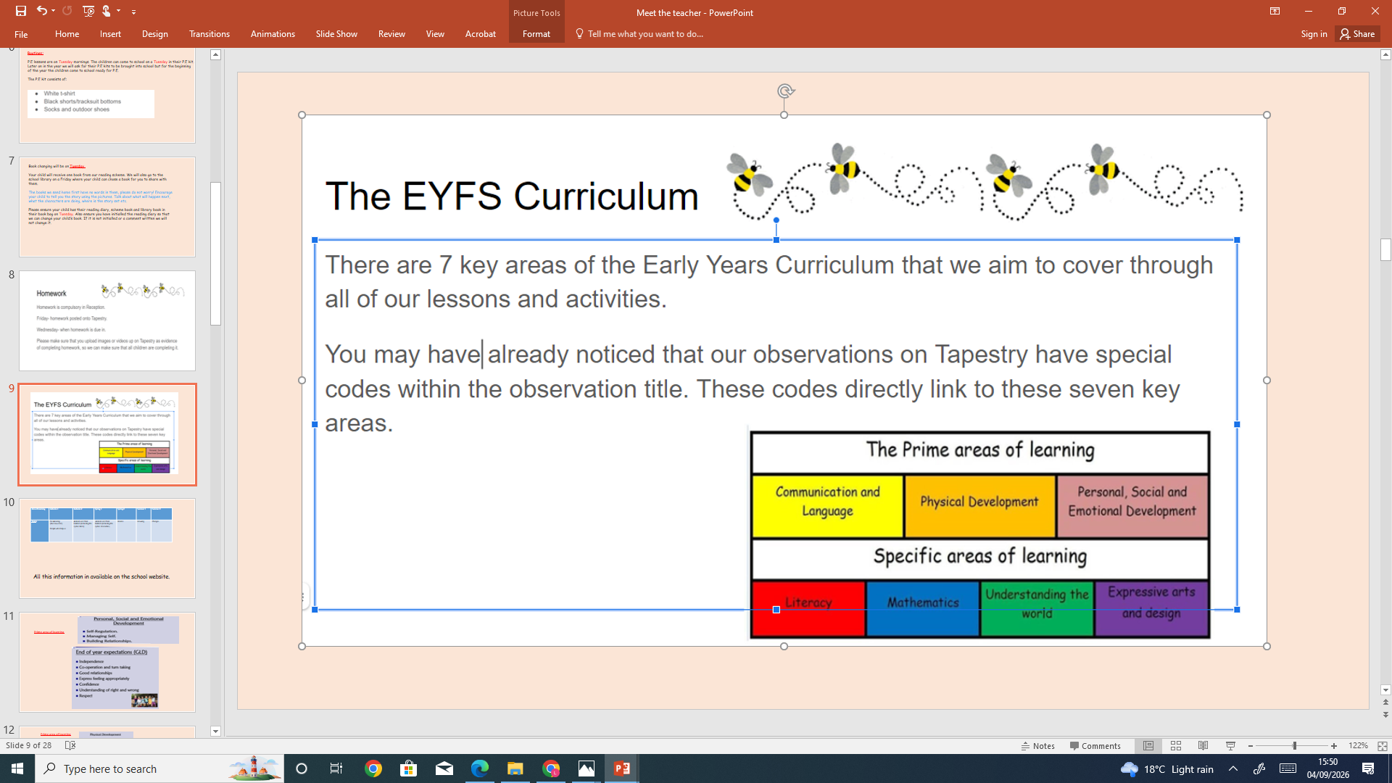

Slide 10
Area of Learning | Autumn 1 | Autumn 2 | Spring 1 | Spring 2 | Summer 1 | Summer 2
Topics | I’m Amazing (Our new start) People who help us | Animals and their habitats (including life cycles: Birds) | Animals and their habitats (including life cycles: Crocodiles ) | Worms | Growing | Changes
All this information in available on the school website.

Slide 11
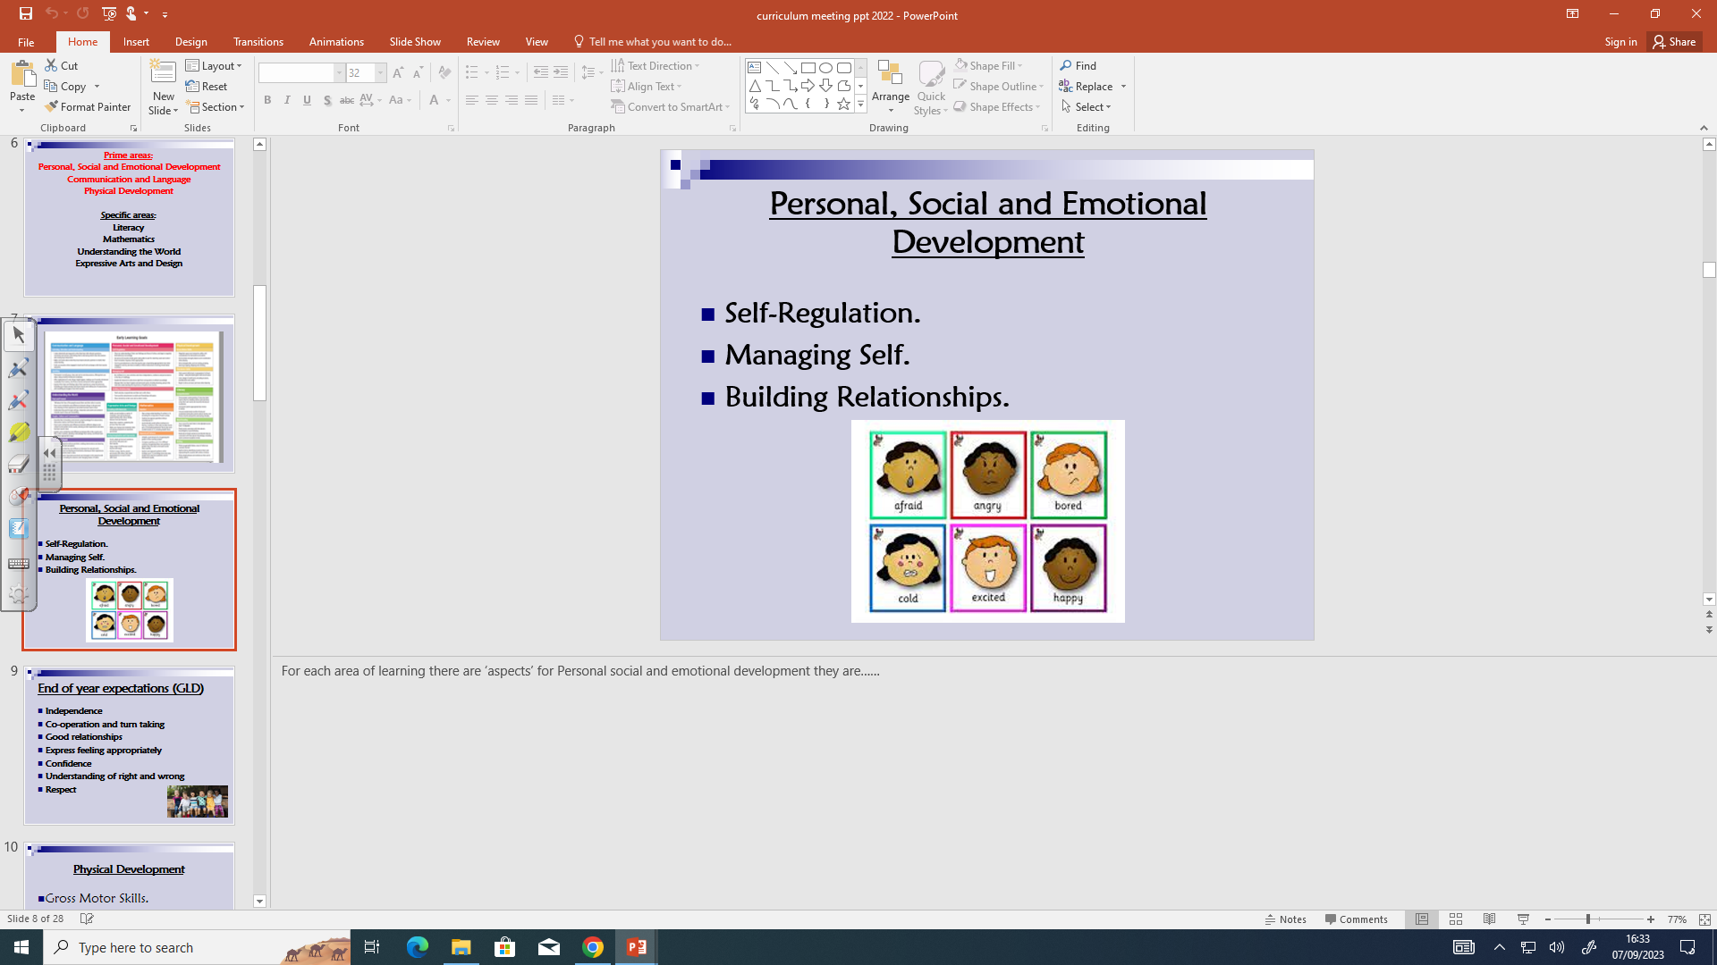
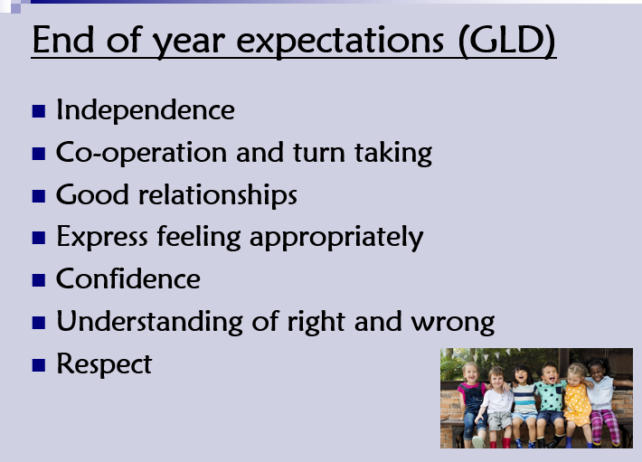
Prime area of learning

Slide 12
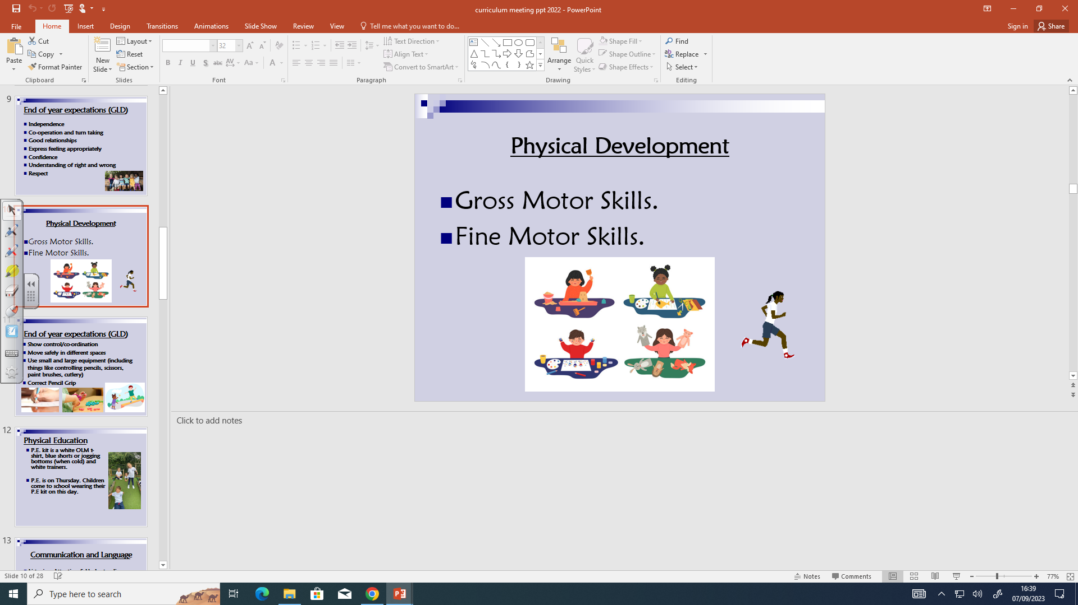
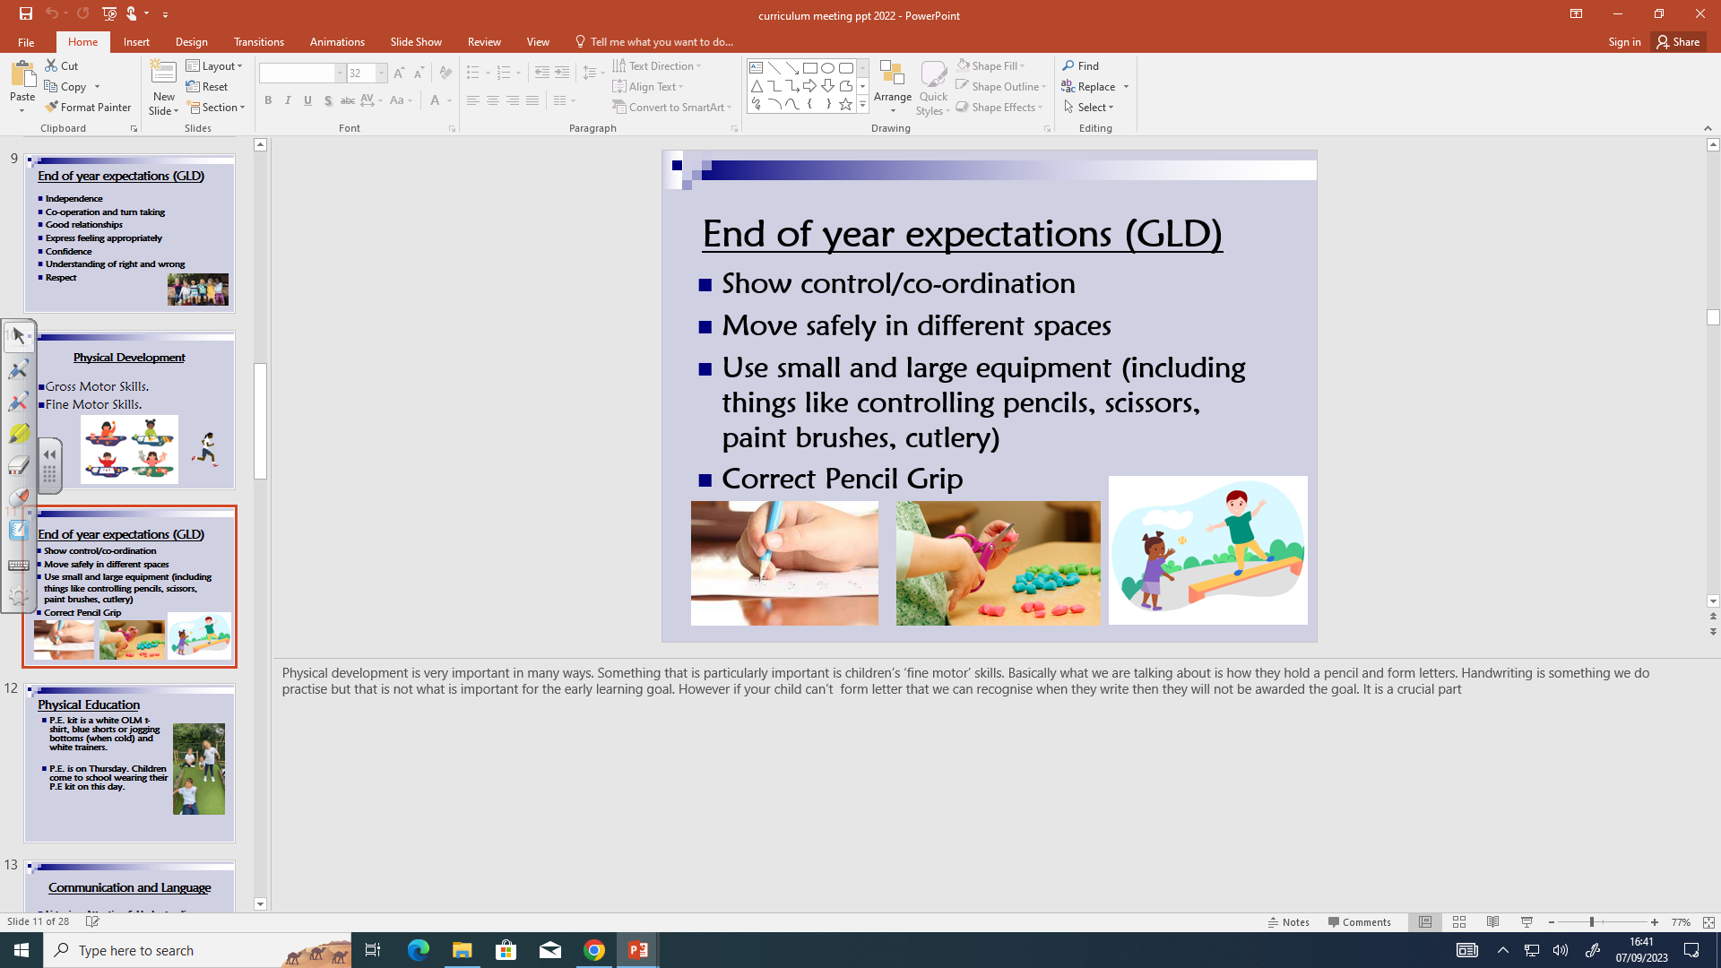
Prime area of learning

Slide 13
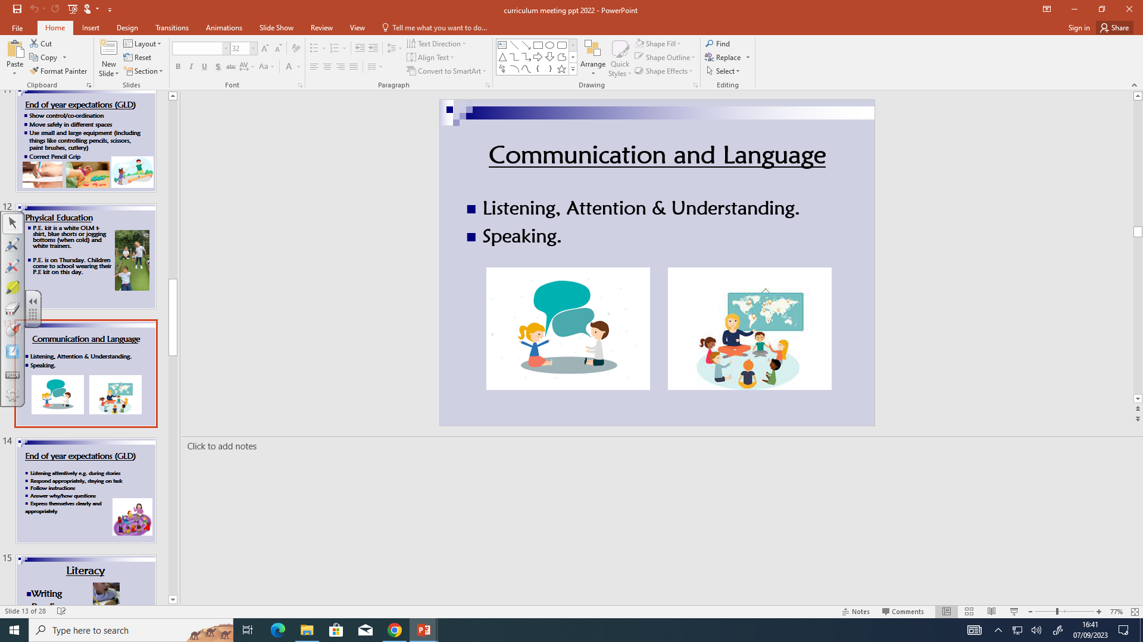
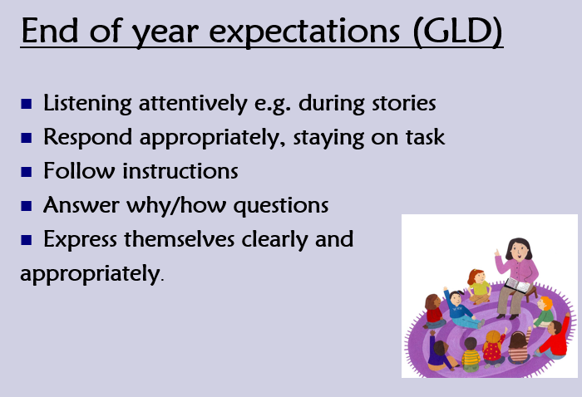
Prime area of learning

Slide 14
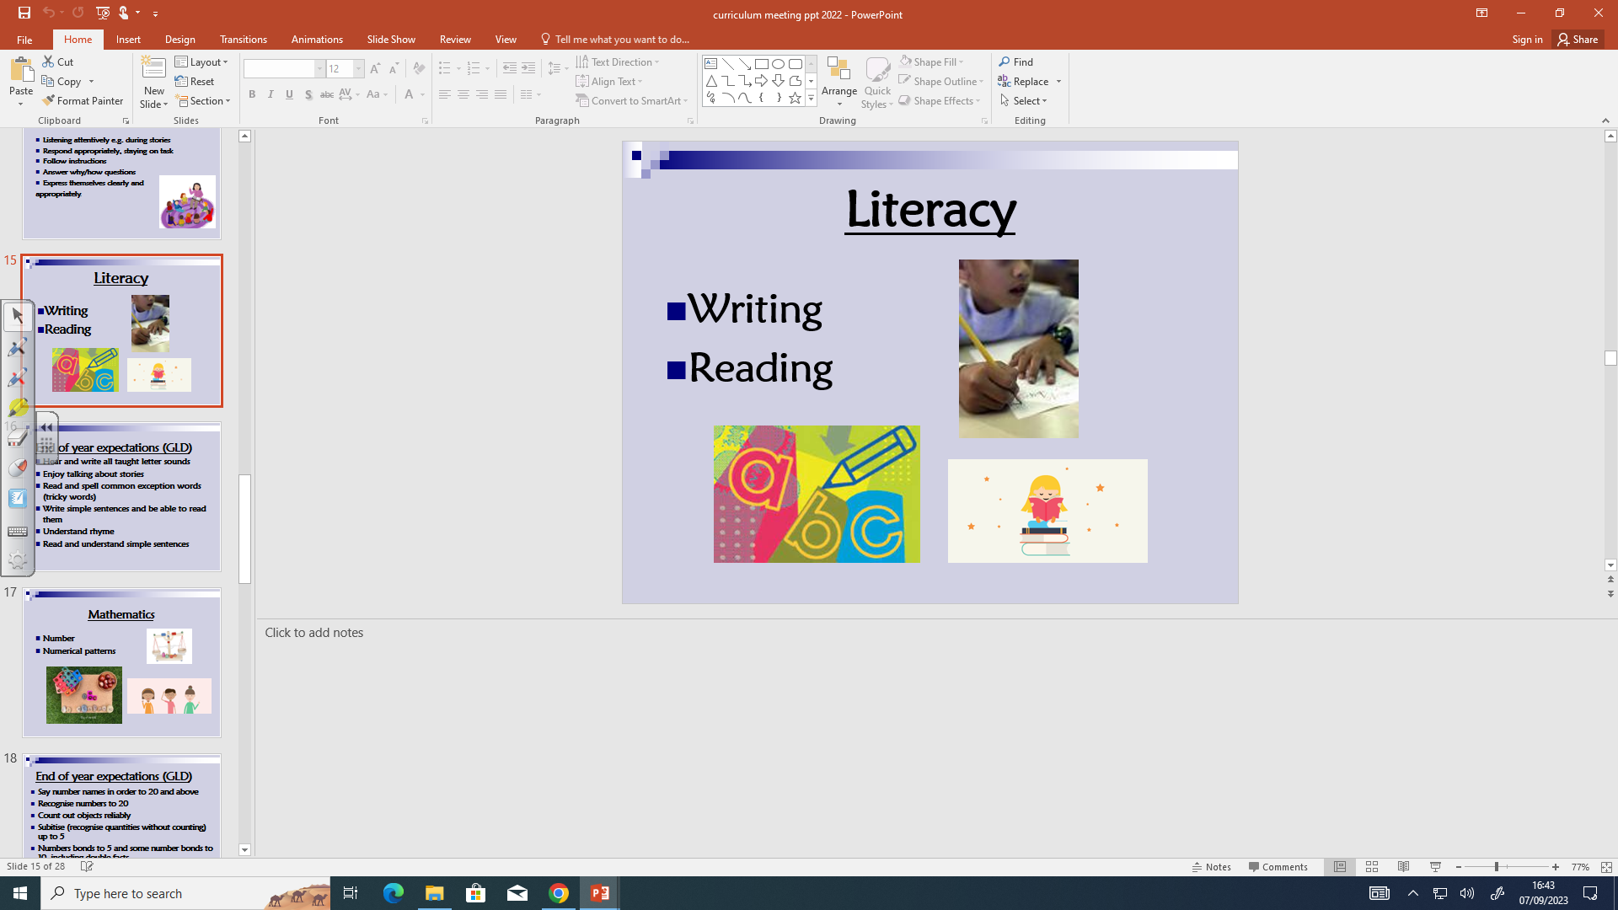
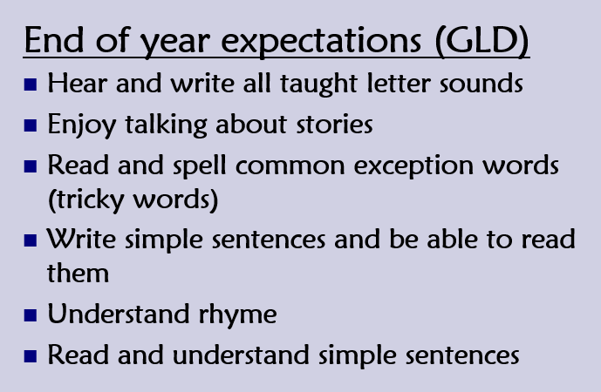
Specific area of learning

Slide 15
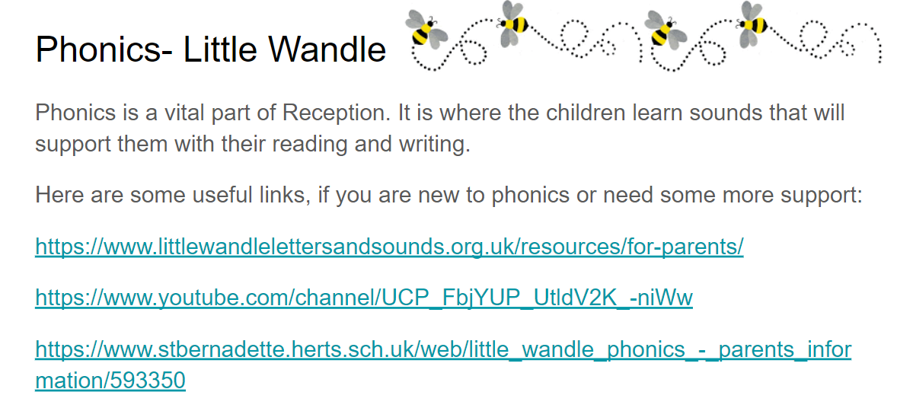
Key ring

Slide 16
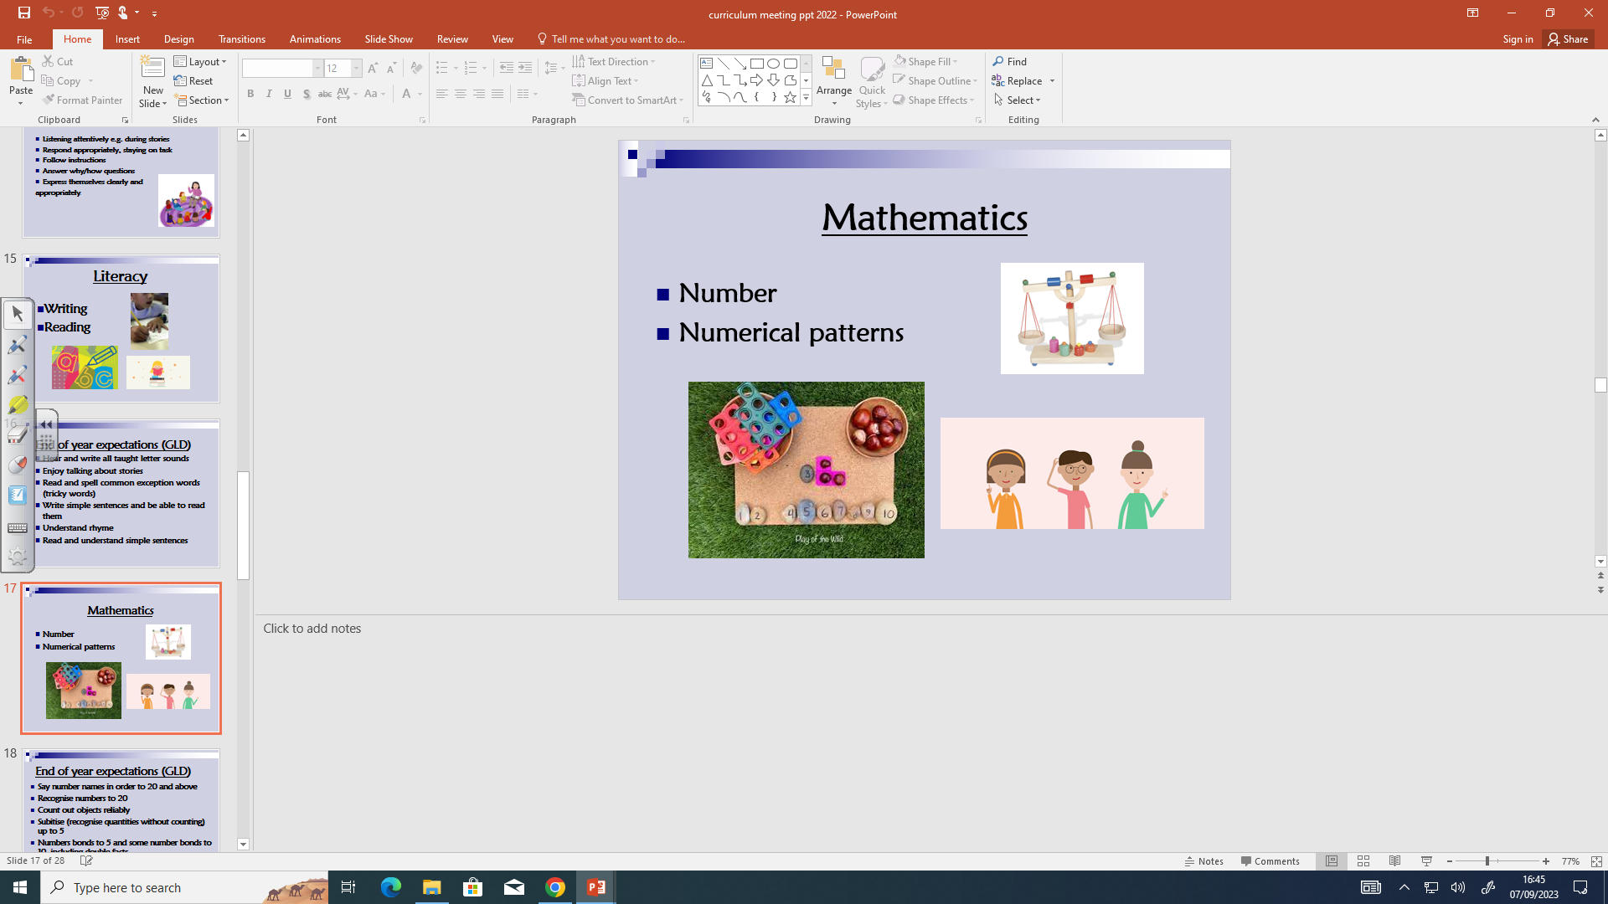
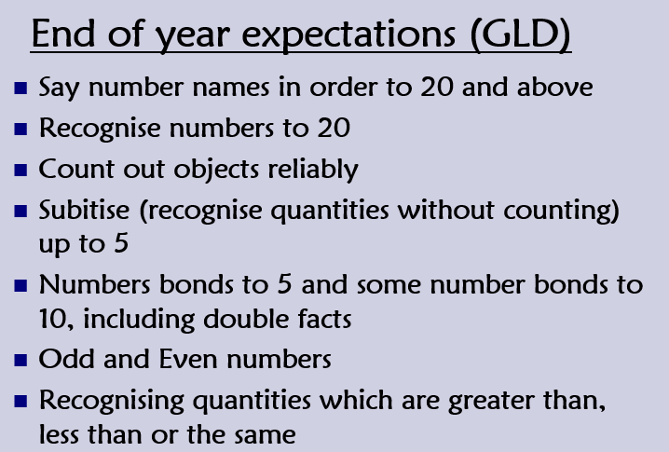
Specific area of learning

Slide 17
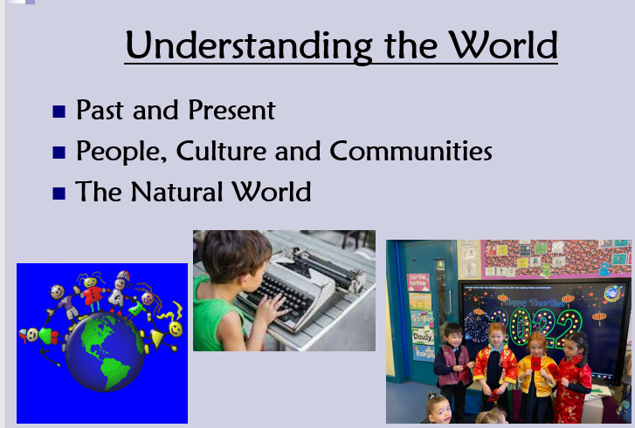
Specific area of learning

Slide 18
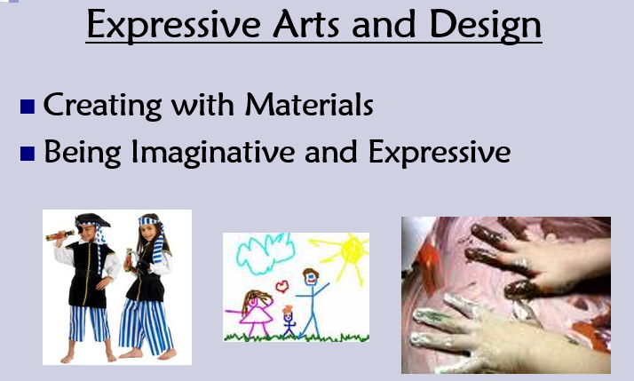
Specific area of learning

Slide 19
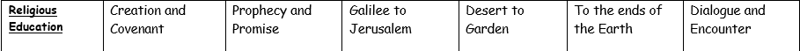
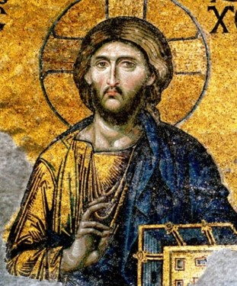

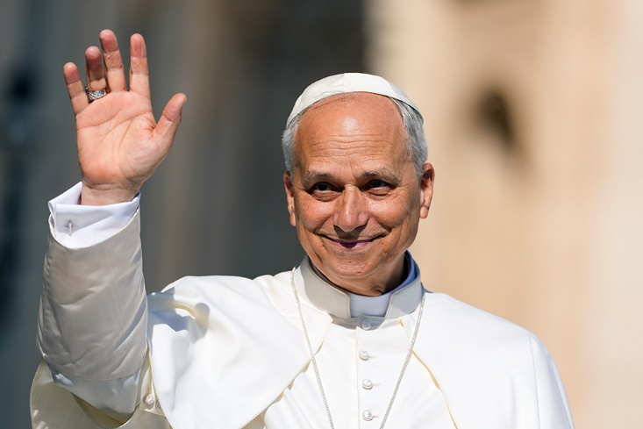
We also have a lesson on R.E each week.
We follow a scheme of work and the topics change every half term.
The curriculum map is on the website.

Slide 20
Assessment:
Government Baseline Assessment: September 2026
Ongoing assessments throughout the year. We complete a phonics assessment at the end of each half term which I send home so if your child is unsure of any of the sounds please work on this over the holidays.
EYFS Profile: June 2027 (GLD)

Slide 21
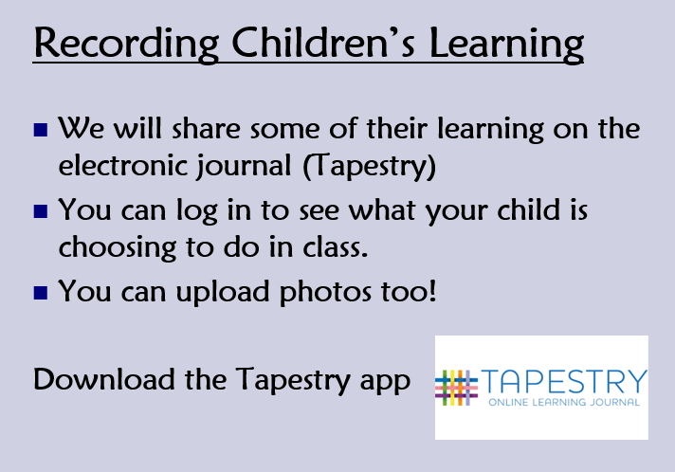
Wow moments

Slide 22
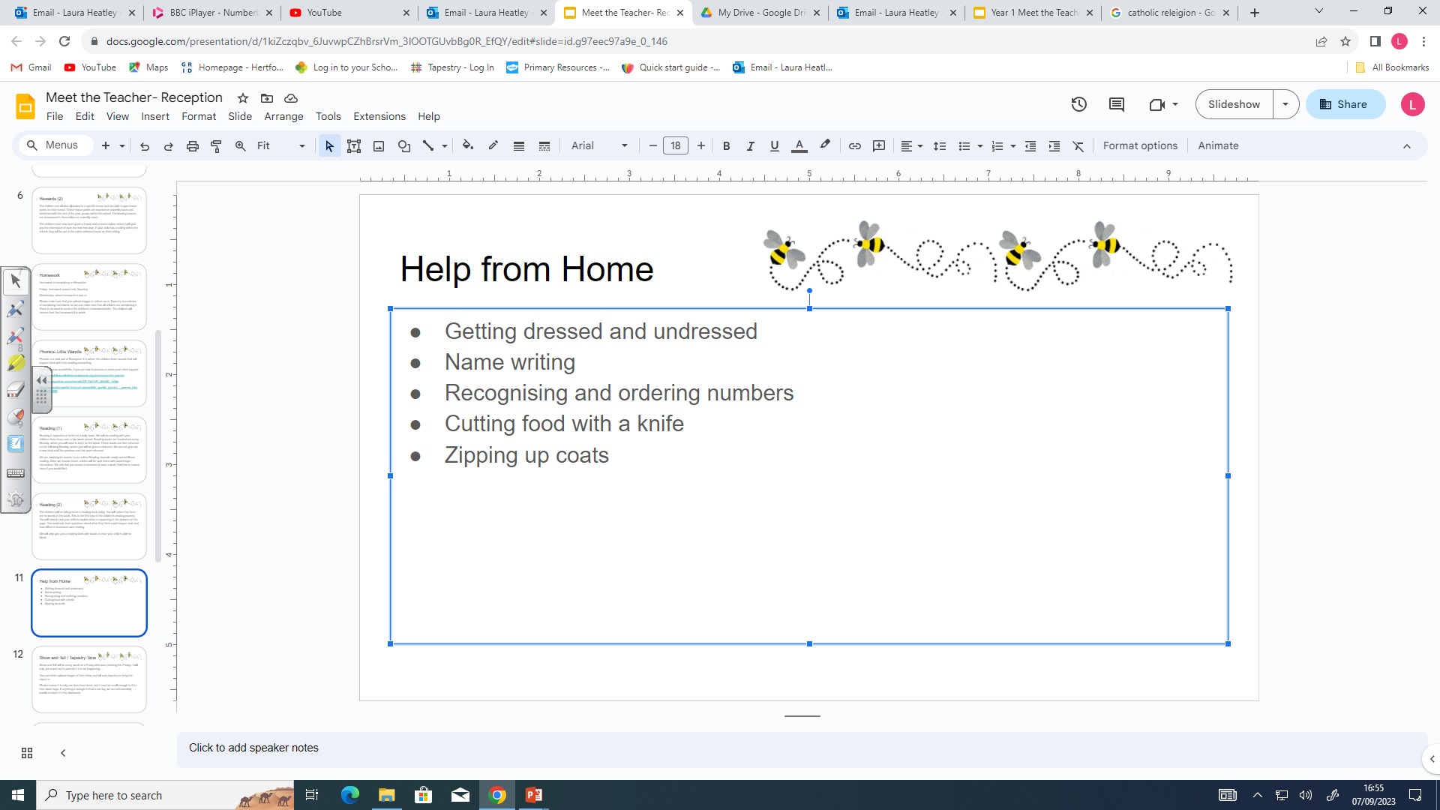
Name writing please only do a capital letter at the beginning and the rest lower case letters.

Slide 23
School Trips
Autumn Term: Local walk to the post box to post our Christmas cards.
Spring Term: Local walk to London Colney Library.
Summer Term: Trip to Radlett Theatre by coach.
Other future dates this term:
There is a Reception Welcome Assembly Thursday 8th October at 9.15 with our Year 6 buddies. Parents are welcome to attend this special assembly.
Parents Evening will be in October dates and times will be sent out by the school office nearer the time.

Slide 24

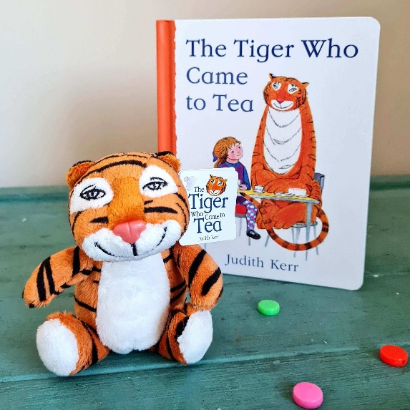
The Tiger who came to Tea.
Every Friday one child in the class will bring home a tiger so that they can have tea together for
the weekend.
Please upload photos to Tapestry and your child can talk about their weekend with the tiger in school.

Slide 25
Our class reward chart.
Every morning the children start on the rainbow then they can move their name up onto sunny/cloudy and then they can move their name up again to sunshine.
When they have 10 sun shines they choose a prize from my special box.
Star of the day

Slide 26


We do have a range of children with differing needs in our class. Obviously each child is unique and different
and some children find things harder than others, for example, sharing toys, sitting still on the carpet.
Please show respect and understanding and help us to celebrate the differences we all have.

Slide 27
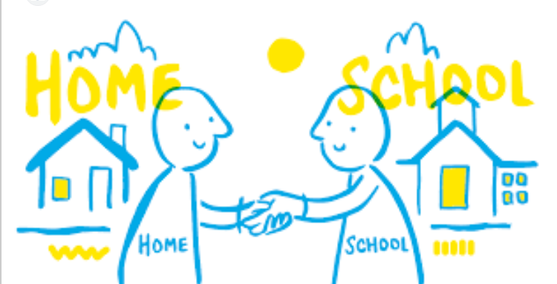
Thank you so much for attending this meeting.
I am really looking forward to working closely with you all to help, support and nurture your child through their learning journey at St Bernadette.

